Slide 1
Sustaining Cradle-to-Grave Control of Radioactive Sources (INT-9182)
Meeting on the development, revision and implementation of the safety case and safety assessment
Indonesia, 15 – 19 May 2017
Background and Definitions
Management options for DSRS
Radioactive Waste and Spent Fuel Management Unit
Waste and Environmental Safety Section (WES),
Division of Radiation Transport and Waste Safety (NSRW)
Department of Nuclear Safety and Security

Slide 2
Content
Basics and definitions
Predisposal considerations
Disposal considerations
Notes:
We shall begin this lecture by looking at the kinds of sources that, typically, cause difficulties to the authorities through getting lost or forgotten
We then go on to speak about the rationale for characterizing disused sealed sources
Then we cover the IAEA code of conduct and finally we consider methods of disposal

Slide 3

What is a sealed radiation source?
A radiation source is any source capable of emitting ionizing radiation
A sealed radiation source is a small entity containing encapsulated radioactive material of high specific activity. Usually, it has the appearance of a small harmless piece of metal.
IAEA Glossary - SRS:
“A source whose structure is such as to prevent, under normal conditions of use, any dispersion of the radioactive material into the environment”

Slide 4
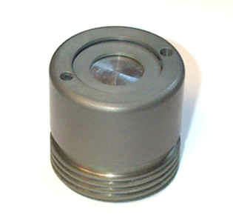
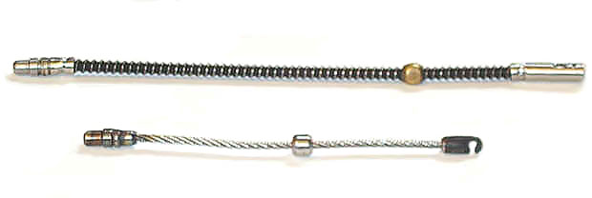

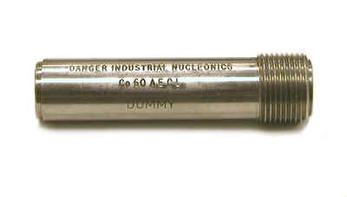
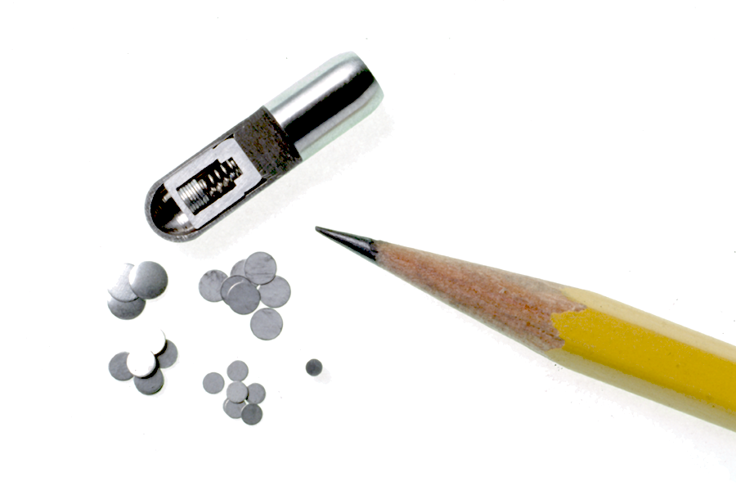
Examples of sealed radioactive sources
Common radionuclides:
Iridium-192
Cobalt-60
Caesium-137
etc.

Slide 5
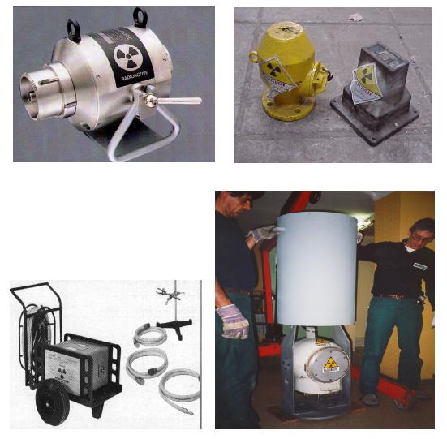
Sealed sources in their shields
Notes:
This slide shows some typical sealed sources in their working shields. The one at bottom left is the type of device used for non-destructive testing ie radiography of welded components. The device enables one of the coiled tubes to be attached so that the source can be routed along the tube to the desired location. This can be done with the operator standing in a safe position.
In the case of sealed sources, shielding is usually an integral part of the original storage and/or transport package. The dimensions and type of shielding depend on the activity and the radionuclides to be shipped.

Slide 6
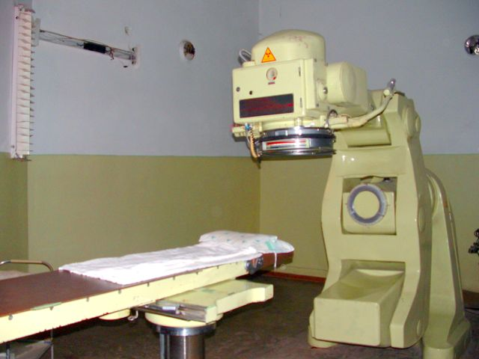
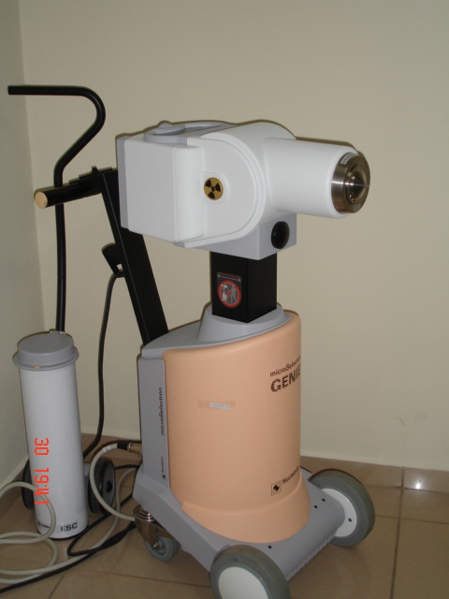
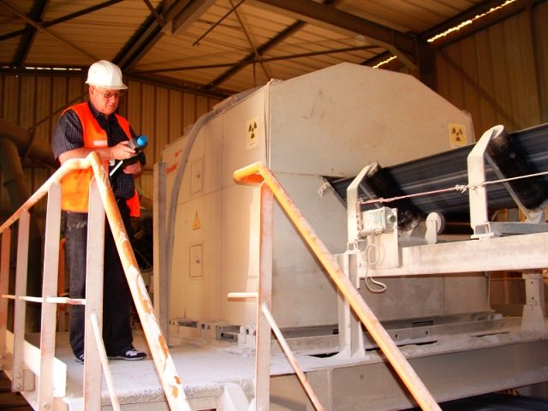
Sealed sources in application
Co-60 teletherapy
brachytherapy suite
Industrial Cf-252 source (0.2TBq or 5.4Ci)i
Notes:
AGAT and Gammacell 220

Slide 7
Storage and disposal
Storage
The holding of radioactive sources, spent fuel or radioactive waste in a facility that provides for their/its containment, with the intention of retrieval
Disposal
Emplacement of waste in an appropriate facility without the intention of retrieval

Slide 8
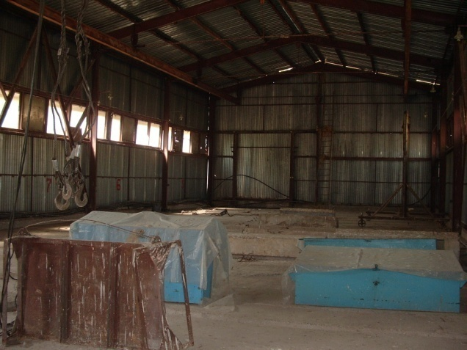
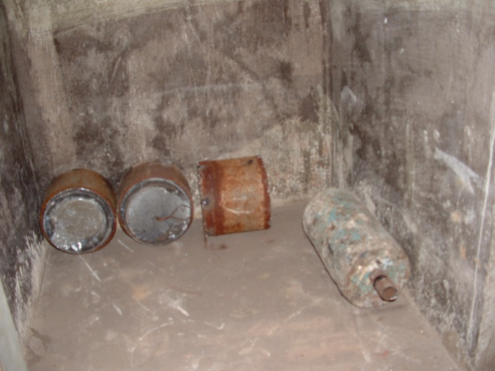
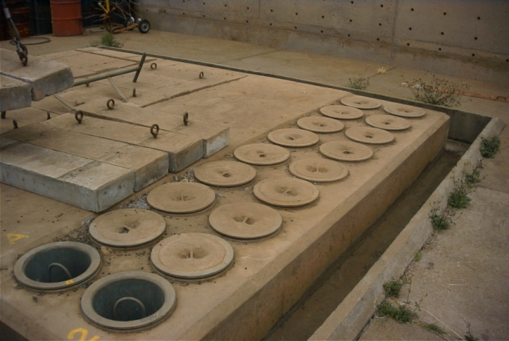
Management options for disused sources (DSRS)
Return to supplier
Interim storage
Decay storage and clearance
Disposal
Notes:
Borehole - BOSS

Slide 9
Steps in the management of DSRS
Disused Sealed Radioactive Source
Is the source leaking?
No
Characterisation –
is the source still useable?
Yes
No
Yes
Storage for potential use
Transfer to another user
Conditioning
Is it possible to return the source to supplier
Yes
Return to supplier
No
Characterisation for disposal
Very short lived
Short lived
Long lived
Are clearance levels met?
Conditioning
Conditioning
No
Decay storage
Storage
Storage
Yes
Manage as non-radioactive waste
Near-surface Disposal
BoreholeDisposal
Geological Disposal

Slide 10
Safe management of DSRS
The following aspects should be considered in respect of the safe management of spent and disused sealed sources:
(a) The further authorized use of the disused source by some other authorized organization
(b) Return of the source to the supplier
(c) Temporary storage in its original shielding (for example for radionuclides with half-lives of less than 100 days)
(d) Conditioning (for example overpacking)
(e) Interim storage in a dedicated storage facility
(f) Disposal

Slide 11
Safe management of DSRS
The most important consideration in the management of sealed sources, once they are no longer useful, is the maintenance of continuity of control
The operator and the regulatory body should make provision to maintain and periodically review the status of control of such devices and material
Notes:
While disused sealed sources are usually a small fraction of the volume of radioactive waste generated by a particular operator, they may dominate the activity content of the waste arisings. It should be noted that, although the radiation output of teletherapy sources and other large sources may have fallen below useful levels, the potential for injury from such sources remains substantial. It should be noted in particular that ¹³⁷Cs teletherapy sources normally contain caesium compounds in dispersible form and represent a severe hazard should their primary containment be breached.
The most important consideration in the management of sealed sources, once they are no longer useful, is the maintenance of continuity of control. The operator and the regulatory body should make provision to maintain and periodically review the status of control of such devices and material.

Slide 12
Safe management of DSRS
Wherever possible, when purchasing sealed sources, contractual arrangements should allow the return of sources to the manufacturer or predetermined waste manager following use
Recycling and reuse can involve the following activities:
  Reuse of sealed sources by the owner or a new owner
  Recycling of sealed sources by the manufacturer
  Decontamination and/or reuse of material
  Recycling and reuse of material that fulfils the conditions for the removal of regulatory control
Notes:
The most sustainable option for managing disused sealed sources is to recycle them for further use. If this is not possible, the preferred management option for disused sealed sources and always for spent sources is the return of the source to its supplier. This option is not always available for many old sources; however, as the original supplier may not be known or may no longer exist. This is particularly important for high activity sources from which regulatory control cannot be removed until after many years of decay storage or for sources containing long lived radionuclides.
Recycling and reuse can involve the following activities:
(a) Reuse of sealed sources by the owner or a new owner with appropriate legal provisions;
(b) Recycling of sealed sources by the manufacturer;
(c) Decontamination and/or reuse of material such as equipment and protective clothing;
(d) Recycling and reuse of material that fulfils the conditions for the removal of control from material as defined by the regulatory body.

Slide 13
Return to supplier
Return of DSRS to the supplier is often the best option and is strongly recommended by the IAEA
Most new contracts for purchase of sources contain a clause for the return of the sources once they are spent
This method is however not available for many old sources as the original supplier is unknown or no longer exists
Also, lack of money has in some cases hindered the return of SRS as the cost of packaging and transport can be considerable
Expensive – from US$ 100 000 upwards!

Slide 14
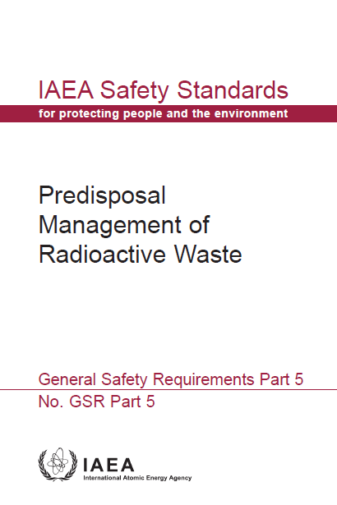
Safe management of DSRS
Once the disused sealed source is declared radioactive waste, its safe management should comply with the safety requirements for the management of radioactive waste
Safety related details of the history of disused sealed sources, considered as waste, should be included in the inventory
Notes:
While spent or disused sealed sources may be a small fraction in terms of the volume of the radioactive waste generated by a particular operator, they may dominate in terms of the activity content of the radioactive waste generated. It is essential to note that, although the radiation output of teletherapy sources and other large disused sources of radiation may have fallen below useful levels for their initial purposes, the potential for radiation induced injury from such sources remains substantial. It should be noted that 137Cs teletherapy sources may contain caesium compounds in a dispersible form and that these can represent a very significant hazard if their primary containment is breached.

Slide 15
Safe management of DSRS
Sealed sources are considered to be disused when:
  the practice is decided not to be continue,
  they have decayed to the extent that they are no longer useful for their original purpose,
  because the appliance in which they are housed has become outdated, or
  because routine tests have indicated that the source is leaking.
Spent or disused sealed sources are not considered waste in certain States, but the safe management of such sources is still achieved by compliance with the requirements for radioactive waste
Notes:
While disused sealed sources are usually a small fraction of the volume of radioactive waste generated by a particular operator, they may dominate the activity content of the waste arisings. It should be noted that, although the radiation output of teletherapy sources and other large sources may have fallen below useful levels, the potential for injury from such sources remains substantial. It should be noted in particular that ¹³⁷Cs teletherapy sources normally contain caesium compounds in dispersible form and represent a severe hazard should their primary containment be breached.

Slide 16
Safe management of DSRS
For spent and disused sealed sources with short half-lives, secure storage for decay may be the preferred option
All spent and disused sealed sources should be conditioned
Long lived sources are generally conditioned by means of encapsulation into welded steel capsules to facilitate future management
Conditioning methods should be approved by the regulatory body
Notes:
For spent and disused sealed sources with short half-lives, not exceeding around 100 d, and of high activity (e.g. 192Ir sources as used in medical applications and in gamma radiography), secure storage for decay may be the preferred option.
All spent and disused sealed sources should be conditioned unless the half-life of the radionuclides they contain is short enough to permit their removal from regulatory control in a period of around two to three years).
Long lived sources are generally conditioned by means of encapsulation into welded steel capsules to facilitate future management. Conditioning methods should be approved by the regulatory body.

Slide 17
Safe management of DSRS
Where the operator does not have the expertise for the conditioning of spent and disused sealed sources or adequate storage facilities, arrangements should be made to transfer the sources to another licensed organization with proper and adequate facilities
Centralized facilities should be established for the safe long term storage of spent and disused sealed sources containing 226Ra, 241Am and other long lived radionuclides
Notes:
In instances where the operator does not have either the facilities or the expertise for the conditioning of spent and disused sealed sources by encapsulation or adequate storage facilities, arrangements should be made to transfer the sources to another licensed organization with proper and adequate facilities. Centralized facilities should be established for the safe long term storage of spent and disused sealed sources containing 226Ra, 241Am and other long lived radionuclides.

Slide 18
Safe management of DSRS
Sealed sources should not be subjected to compaction, shredding or incineration;
Sealed sources should not be removed from their primary containers,
Peripheral components of large irradiation equipment should be removed, monitored and disposed of appropriately;
A safety assessment and environmental impact assessment should be carried out before any operations are undertaken.
Notes:
The management of disused sealed sources can involve potentially serious hazards. Sealed sources should not be subjected to compaction, shredding or incineration. As a general principle, the overriding need for safety means that sealed sources should not be removed from their primary containers, nor should the container be physically modified. Peripheral components of large irradiation equipment (those not directly associated with the source) should be removed, monitored and disposed of appropriately. A safety assessment and environmental impact assessment should be carried out before any operations are undertaken. For sources (such as spent radium sources) with a potential for leakage, particular radiological precautions should also be taken during the handling and storage. Special attention should be paid to monitoring for surface and airborne contamination. These sources should be stored in a dedicated area with appropriate ventilation and equipment

Slide 19
Safe management of DSRS
For sources, such as spent radium sources, with a potential for leakage, particular radiological precautions should also be taken during the handling and storage.
Special attention should be paid to monitoring for surface and airborne contamination. These sources should be stored in a dedicated area with appropriate ventilation and equipment.
Notes:
The management of disused sealed sources can involve potentially serious hazards. Sealed sources should not be subjected to compaction, shredding or incineration. As a general principle, the overriding need for safety means that sealed sources should not be removed from their primary containers, nor should the container be physically modified. Peripheral components of large irradiation equipment (those not directly associated with the source) should be removed, monitored and disposed of appropriately. A safety assessment and environmental impact assessment should be carried out before any operations are undertaken. For sources (such as spent radium sources) with a potential for leakage, particular radiological precautions should also be taken during the handling and storage. Special attention should be paid to monitoring for surface and airborne contamination. These sources should be stored in a dedicated area with appropriate ventilation and equipment.

Slide 20
Conditioning and Packaging of DSRS
Conditioning
  Operations that produce a waste package suitable for handling, transport, storage and/or disposal
  May include
    Conversion of waste to solid waste form
    Enclosure of waste in containers
    Providing an overpack
Packaging
  Preparation of radioactive waste for safe handling, transport, storage and/or disposal by means of enclosing it in a suitable container

Slide 21
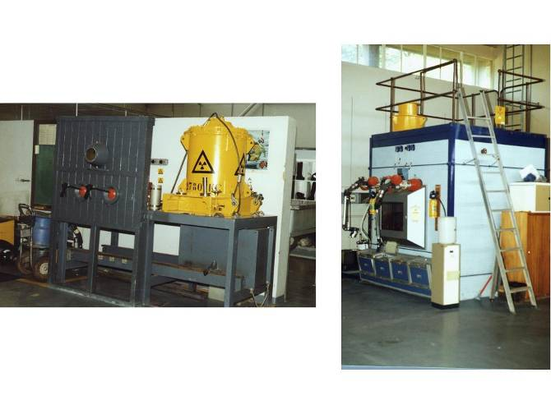
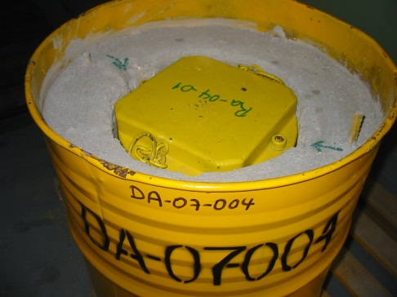
Conditioning and Packaging of DSRS
Disused source handling facility
  Source characteristics
  National or regional waste management strategy
  Conditioning performed for storage must take possible disposal option into consideration

Slide 22
Storage of DSRS
Types of storage:
Decay: to allow decay to permit onward handling or clearance
Buffer: temporary storage to provide stock for ongoing processing
Interim: storage for waste awaiting development of successive steps
Strategic: for material that may be a resource in the future
Legacy: old stores that did not incorporate proper retrievability criteria and proper container and waste form performance criteria.
Duration of storage
  Short or temporary
  Medium term
  Extended (several decades, but there must be a defined end point)

Slide 23
Storage of DSRS
Issues to consider:
  Storage conditions are not always satisfactory
  Most sources remain in storage pending availability of a suitable disposal option
  Adequate final management option for sources containing short-lived radionuclides
  Centralized storage facility for a country/region
  Various options can be used as storage facilities
  Record keeping and radiation protection principles essential

Slide 24
Selection of the storage option (type)
Influenced by several factors: capacity, flexibility (container size), containment, radiation protection, access, surveillance required and security
Centralised storage can provide much better conditions for long-term storage of DSRS:
  reduces the likelihood of loss
  safeguards controls and
  controls for the physical security of nuclear materials are more efficient.
Centralised waste stores are particularly relevant for countries that have large numbers of DSRS
enables them to be brought under central management and control as soon as possible.

Slide 25
Decay storage
Very efficient and economic waste management procedure.
However, it implies:
accurate administrative control measures
very careful waste segregation
activity measurements at the origin of waste production and at the end of the decay storage period
When the radionuclides in the waste have half-lives of less than a few years (e.g. ¹⁹²Ir), decay storage will usually be an appropriate management strategy for all but the most powerful sources.
In decay storage, wastes are placed in a facility where they can safely decay for the ten to twenty half-lives needed to allow the radioactivity to reach very low levels.

Slide 26
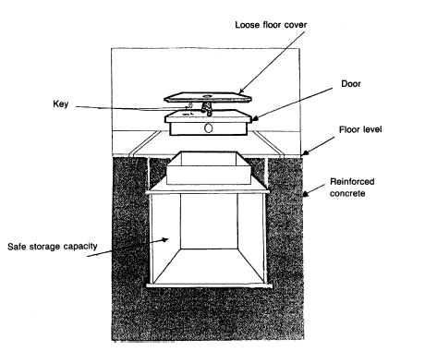
Storage in safes
This option, which is only suitable for small size and a small number of containers, utilizes floor safes which are mass produced, inexpensive, readily available and recognized as a secure system
Unauthorized intrusion is difficult, and removal of the safe would not be an easy operation if the safe is installed in a foundation

Slide 27
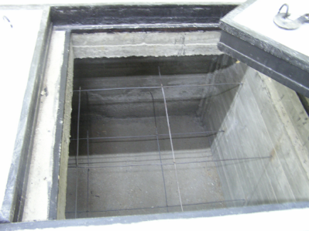
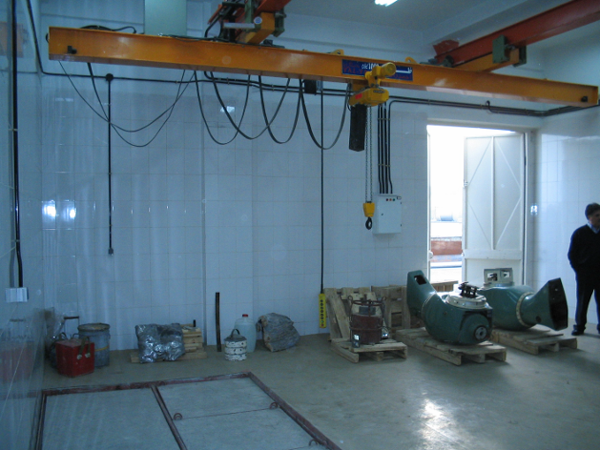
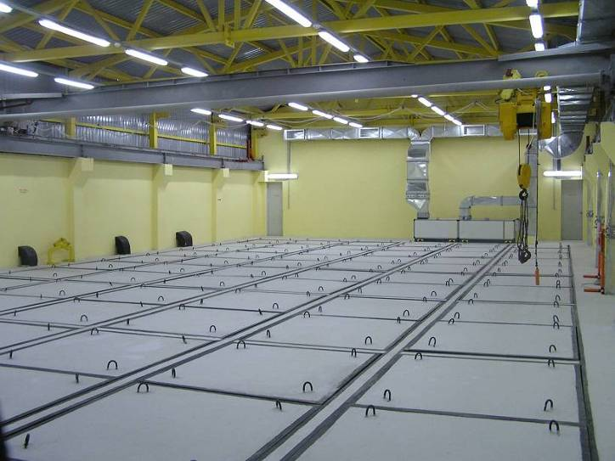
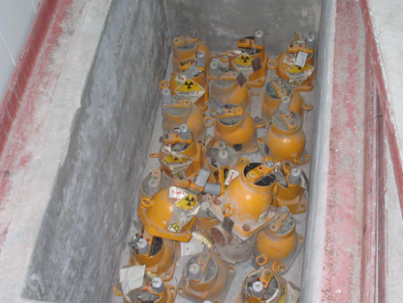
Storage in concrete bunkers
A reinforced concrete bunker could be used for the storage of small, medium and large containers, depending upon the size of the bunker
A bunker designed with a heavy lid could serve as a cheap but secure system for the storage of small and medium size packages
A larger bunker with a heavy lid could house large packages as well as small and medium ones and would be useful where there are larger numbers of sources for storage

Slide 28
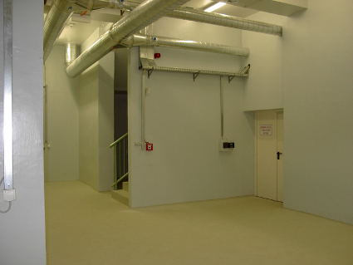
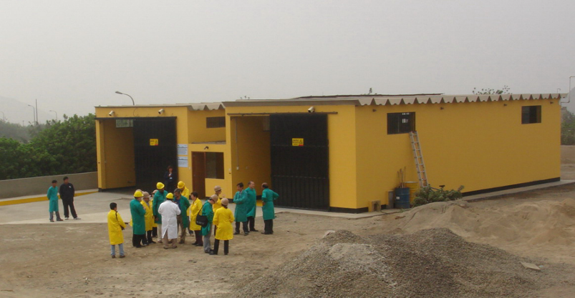
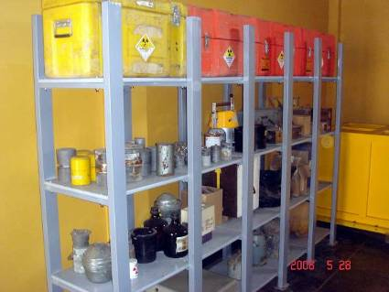
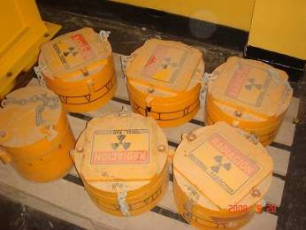
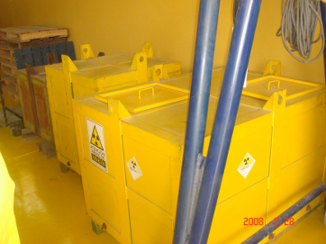
Storage in well-protected rooms
The containers are stored in a strong room with a secure door, high security locks and an intruder alarm.
Small and medium sized containers may be arranged for convenience on shelves whereas large containers would be placed on the floor.
storage of unconditioned DSRS
long term storage of conditioned DSRS

Slide 29
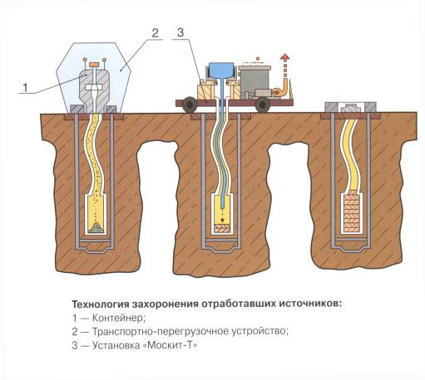
Storage in shallow boreholes
Boreholes between 5 and 40 m deep
Steel compartment at the bottom of the borehole that can contain up to PBq quantities of DSRSs; such quantities generate significant heat
To help with heat dissipation, molten lead is poured into the compartment
NB. Radiolysis of water and air may produce nitric acid, which accelerates corrosion

Slide 30
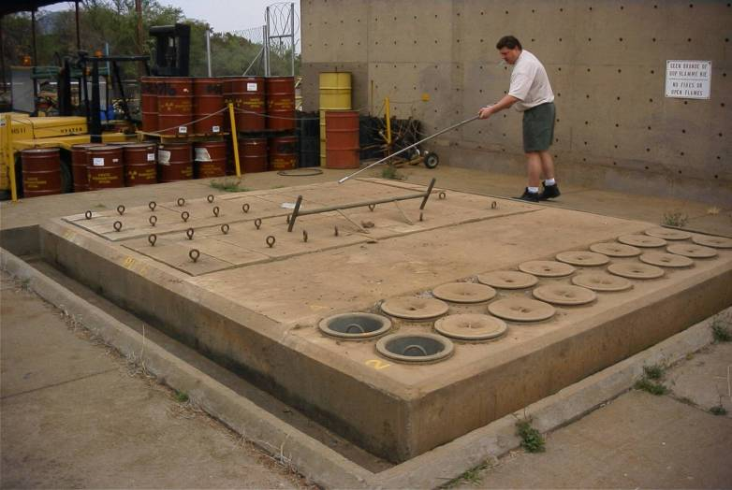
Storage in shallow boreholes

Slide 31
Wet storage systems
In certain facilities, particularly in the large industrial irradiators with ⁶⁰Co sources, a water basin is used for the shielded position of sources from which they are moved into the working position.
These water basins could be used for the on-site temporary storage of spent ⁶⁰Co sources.
A high degree of technical expertise is required to design, commission and operate such a facility.

Slide 32
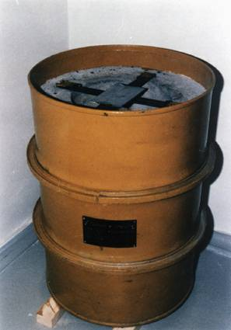
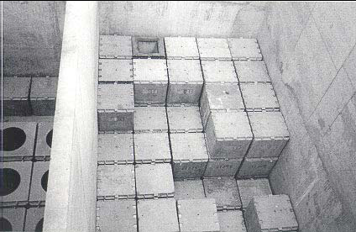
Storage of high activity DSRS (SHARS)
SHARS and original equipment placed in storage container
The use of concrete lined drums or concrete boxes for storage of SHARS in source holders is quite common.
Concrete boxes have the advantage over drums that they are more easily stacked, and can contain greater volume and load.

Slide 33
Requirements for storage
Comprehensive radiation protection
Access control (radiation/contamination controlled areas)
Quality control
Physical security
Handling equipment (hoists, fork-lift trucks, etc.)
Maintenance services
Regulatory Authority controls
Suitable conditioning keeping the end-point in mind
Qualified staff
Retrievability
Inspection
Knowledge management
Funding

Slide 34
Terrorist threat
New paradigm must be built into your safety case for operating and disused sources.
How long will we be concerned about this threat? – Forever!
Concerns many players in the national system of protection.
Ultimate responsibility lies with the Operator.
Safety and security systems must evolve.

Slide 35
Disposal
Disposal options:
  Near-surface disposal facilities – IAEA SSG-29
  Geological disposal facilities – IAEA SSG-14
  Disposal in boreholes – IAEA SSG-1
Many (but not all) DSRS exceed waste acceptance criteria for near-surface disposal
  Localized high activity concentrations, “hot spots”
  Pose unacceptable risks during human intrusion or other exposure scenarios (e.g. erosion)
  Institutional control cannot be assumed to be indefinite
Geological disposal facilities would be suitable but are often not available

Slide 36
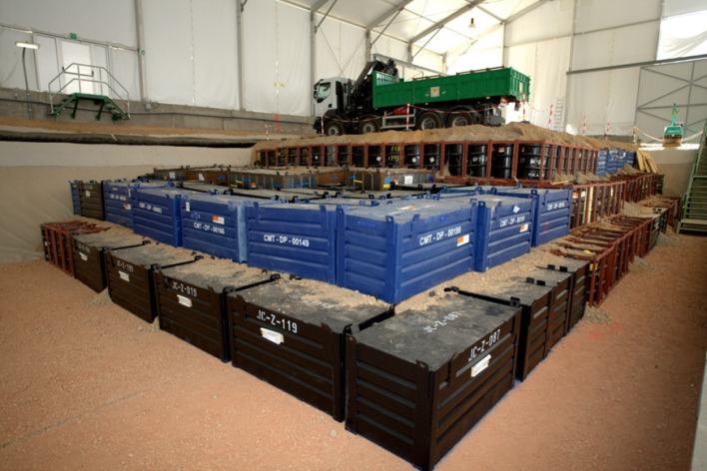
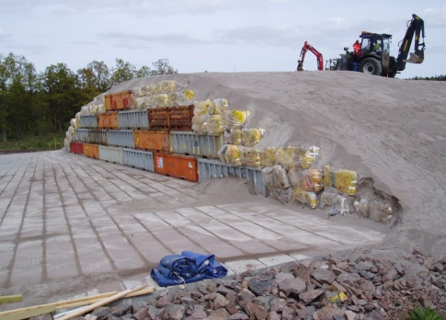
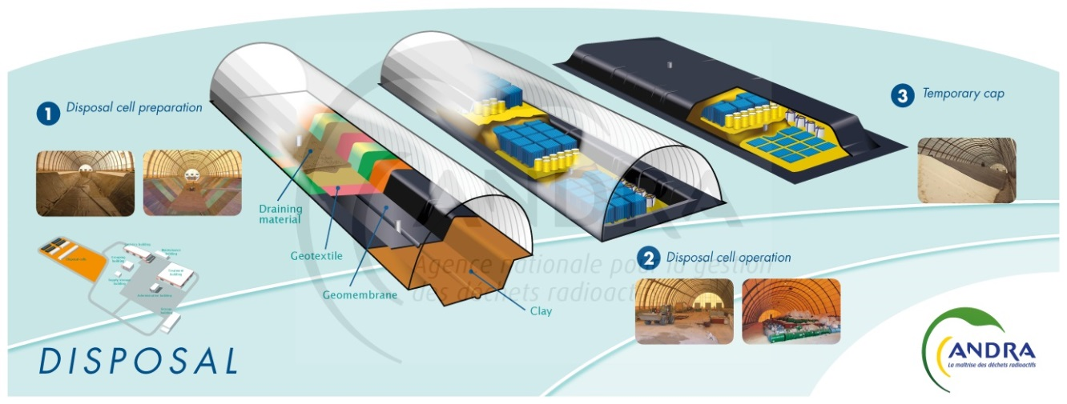
Near-surface disposal: facilities for VLLW
El Cabril, Spain
Oskarshamn, Sweden
CSTFA, Morveilliers, France

Slide 37
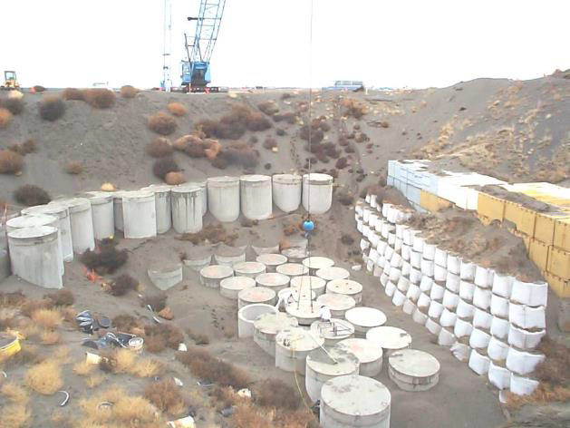
Near-surface disposal: trench facilities
Nevada TS, USA
Vaalputs, South Africa
Richland, USA

Slide 38
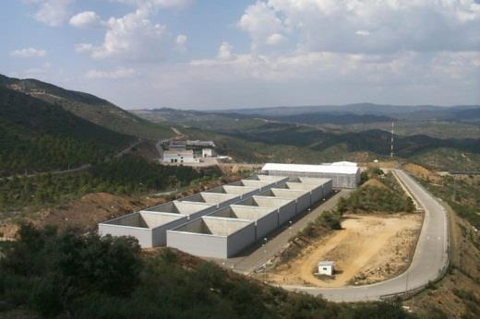
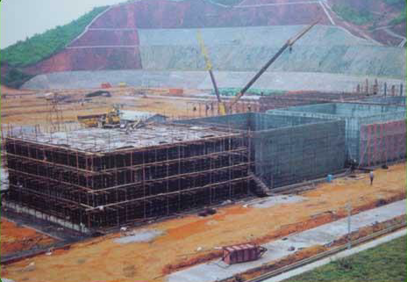
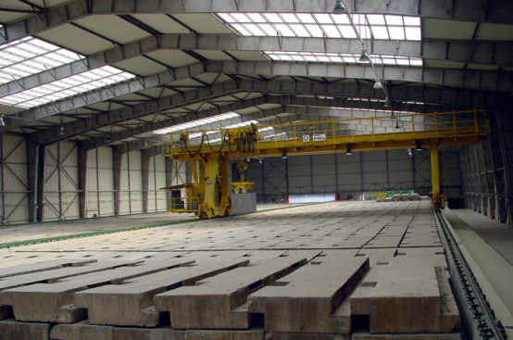
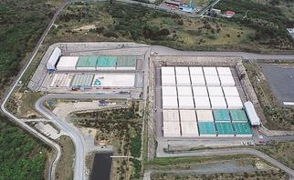
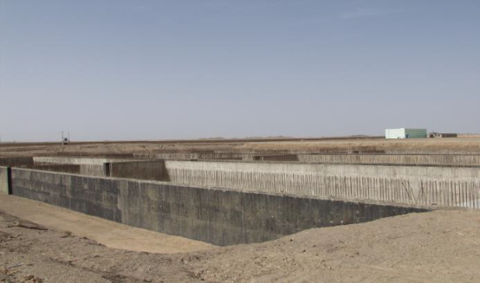
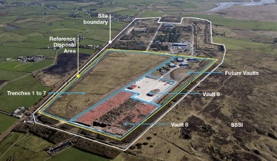
Near-surface disposal: engineered vault facilities
El-Cabril, Spain
L’ Aube, France
Beilong, China
Mochovce, Slovakia
Rokkasho, Japan
NorthWest, USA
LLWR, UK

Slide 39
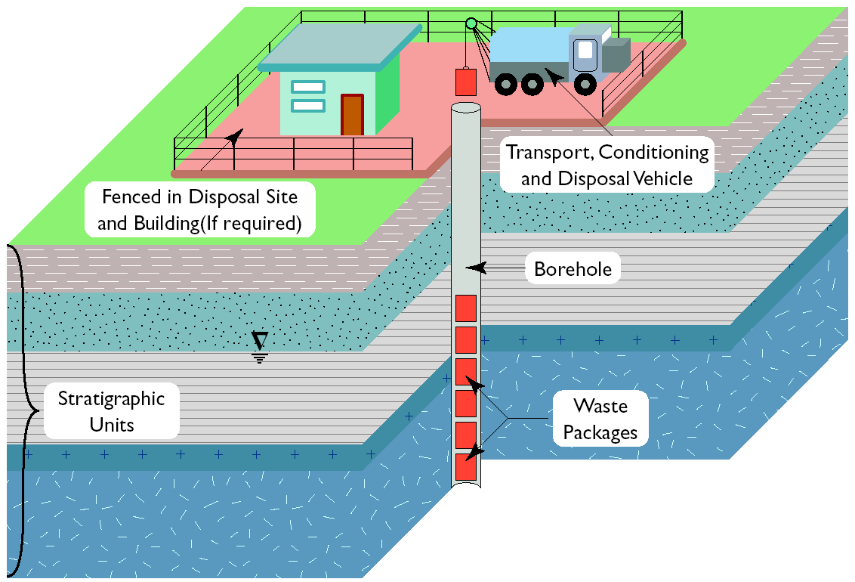
Borehole disposal of DSRS

Slide 40
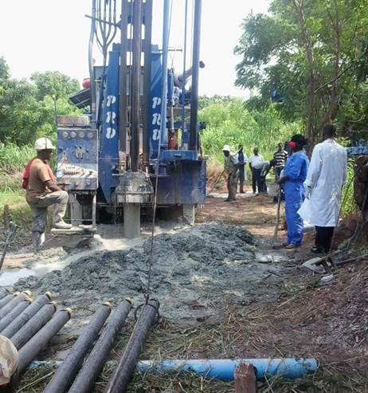
Borehole disposal of DSRS

Slide 41
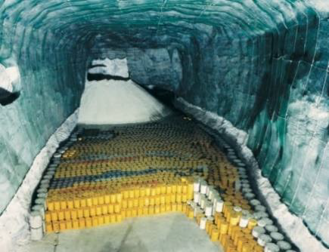
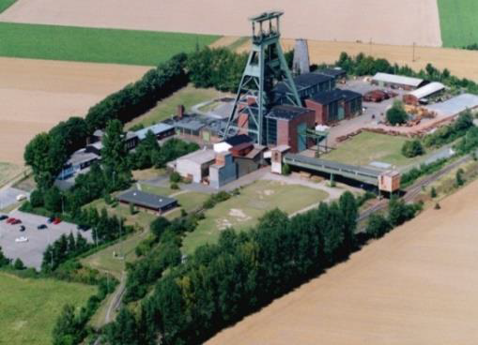
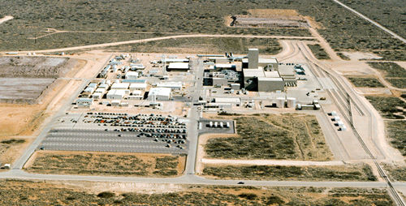
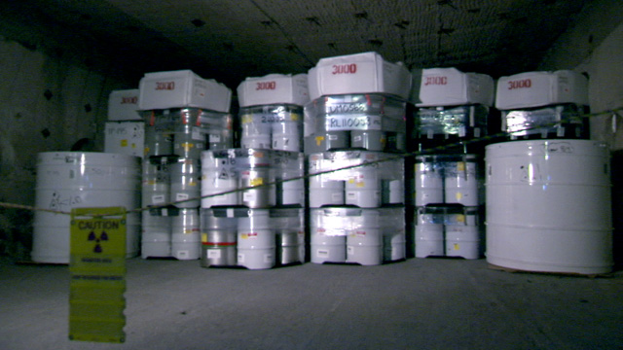
Geological disposal
Morsleben, Germany
Konrad, Germany
WIPP, USA

Slide 42
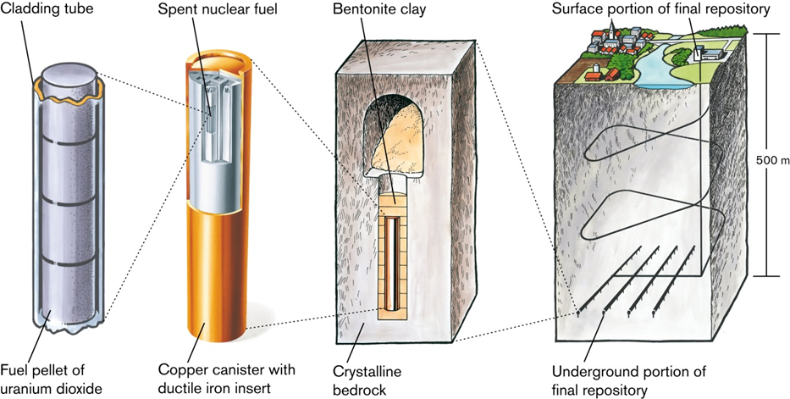
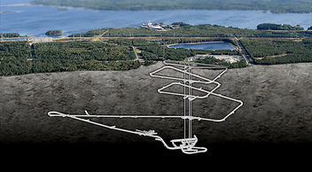
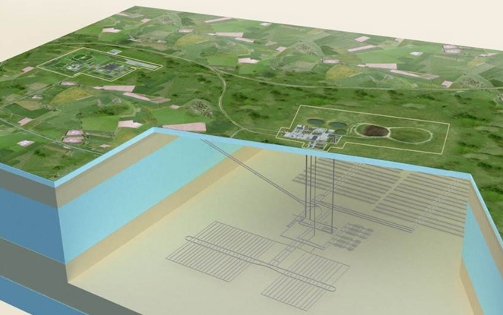
Geological disposal
SKB-3V concept, Sweden
Onkalo, Finland
Cigeo, France

Slide 43
Conclusions
Various management options exist for ensuring safety during the use and pre-disposal management of sources
  Storage is an interim step - it is not a solution
  For sources than cannot be returned to the supplier or recycled / reused, disposal is necessary; various options are available.
The safety of a selected option needs to be demonstrated in a safety case
  The safety case needs to address many requirements such as system understanding, multiple barriers, isolation, containment, radionuclide decay and retardation, future potential doses and risks, and uncertainties – more in later presentations
Notes:
So, to conclude, D values - the radionuclide-specific activity reference levels developed for emergency planning – are is a helpful indicator when considering the day to day safety of sealed radioactive sources. But note that this does not remove the necessity for detailed safety assessments for storage, repository operations and so on
For transport of sealed sources, the transport regulations (A1 and A2 tables) should be used
And for post-closure safety considerations, different issues need to be taken into account. Specifically half-life, mobility and ingrowth are key factors that may determine what style of disposal is needed

Slide 44
Thank you!
Notes:
Thank you!

